Slide 1
SUSTAINABLE DOVELOPMENTAL GOALS
SABA SHAHID – 048
AFRA ASAD -092
MUNESHA -070

Slide 2
IN THE PRESENTATION
01
02
03
04
INTRODUCTION TO SDGS
HISTORY OF SDGS
OVERVIEW OF THE 17 SDGS
CALL TO ACTION

Slide 3
"Imagine a world where no one goes hungry, everyone has equal opportunities, and our planet thrives for generations to come. Sounds like a dream, right? Well, that’s the vision of the Sustainable Development Goals!"

Slide 4
01
INTRODUCTION

Slide 5
What are SDGS?
The Sustainable Development Goals (SDGs) are a set of 17 global goals established by the United Nations in 2015 as part of the 2030 Agenda for Sustainable Development. These goals aim to address the world's most pressing challenges by promoting peace, prosperity, and environmental sustainability for all.

Slide 6
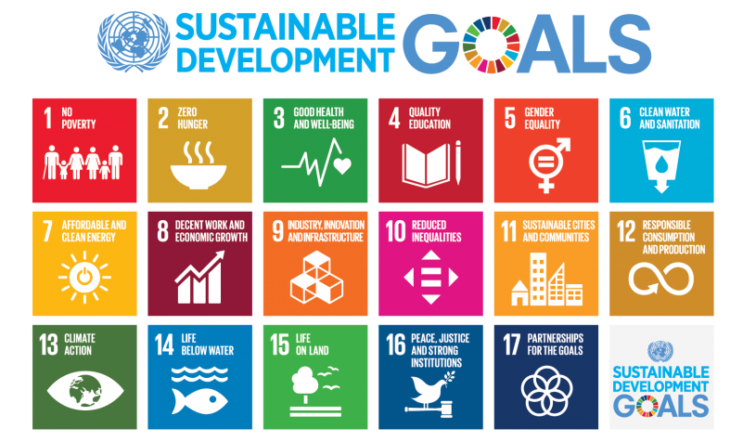

Slide 7
Why SDGS Matter?
The SDGs are vital for addressing the world’s biggest global challenges such as climate change, inequality, health crises, education, and economic instability.
Their universal framework calls for action by governments, businesses, civil society, and individuals to build a better and more sustainable world for everyone.

Slide 8
The 2030 Agenda
The 2030 Agenda was adopted by 193 UN Member States in 2015 and serves as the blueprint for the SDGs. It sets out specific targets for each of the 17 SDGs to be achieved by 2030.
The SDGs promote a holistic approach to development, integrating social, environmental, and economic dimensions.

Slide 9
02
HISTORY OF SDGS

Slide 10
The Millennium Development Goals (MDGs):
Before the SDGs, there were the Millennium Development Goals (MDGs), which were adopted in 2000 and aimed to tackle poverty and hunger, improve education, and health, among other goals.
Successes: The MDGs contributed to major achievements like reducing extreme poverty and improving access to education.
Shortcomings: However, they were criticized for having a narrow focus, primarily on poverty reduction, without considering the broader issues such as environmental sustainability and inequality.

Slide 11
Adoption of SDGs (2015):
In 2015, 193 countries adopted the SDGs, recognizing the need for a more comprehensive and inclusive framework to address a wide range of global challenges.
The SDGs went beyond the MDGs by addressing not just poverty, but also climate change, gender equality, quality education, economic growth, and more.
Importance of Global Cooperation:
The SDGs require global cooperation among governments, businesses, and individuals. Achieving these goals will need partnerships at the international, national, and local levels to drive progress across all sectors.

Slide 12
03
OVERVIEW OF THE 17 SDGS

Slide 14
Pakistan’s Role
As a UN Member State, Pakistan is committed to implementing the SDGs. The country faces a range of challenges but also has significant opportunities to contribute to these global goals.
Examples of Pakistan’s Progress:
SDG 1 (No Poverty): Ehsaas Program aims to reduce poverty by providing financial support and subsidies to those in need.
SDG 4 (Quality Education): Pakistan has made efforts to improve literacy rates and access to education, though challenges remain.
SDG 6 (Clean Water and Sanitation): Pakistan has made strides in improving water access, though issues like water scarcity still need attention.
SDG 13 (Climate Action): Pakistan faces severe climate-related challenges, and the government has adopted various measures, such as afforestation programs.

Slide 15
04
CALL TO ACTION

Slide 16
A collective effort for a sustainable future
:
"The Sustainable Development Goals (SDGs) are a shared responsibility. As individuals, communities, and nations, we all have a role to play in achieving these goals."
"Whether it's through reducing waste, supporting local businesses, advocating for equality, or educating others about the SDGs, every small action counts.“
Importance of Personal Contribution:
"Remember, sustainable development starts with you. What actions can you take today to help build a better future for tomorrow?"

Slide 17
The future depends on what we do today.” – Mahatma Gandhi
"Let’s work together to create a more just, sustainable, and prosperous world for future generations. The time for action is now!"

Slide 18
THANK YOU!

